Slide 1
What is Responsive Layout
Pages change/”not change” according to the screen
Notes:
By Bran

Slide 2
How to change according to the screen
1. Media query
2. Fluid grids
3. Using percentage
4. Write different styles and load accordingly
5. VW/VH , em …
6. etc.

Slide 3
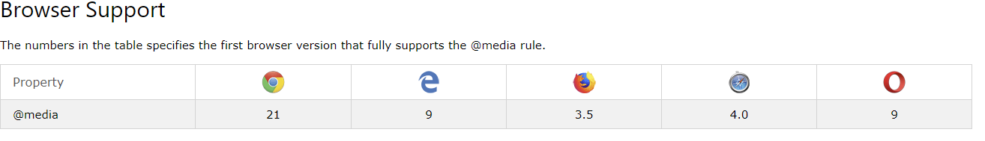
Media query

Slide 4
Parameters
1. Media types
all: Suitable for all devices.
print: Intended for paged material and documents viewed on a screen in print preview mode.
screen: Intended primarily for screens.
speech: Intended for speech synthesizers.
2. Media features
Media features describe specific characteristics of the user agent, output device, or environment. Media feature expressions test for their presence or value, and are entirely optional. Each media feature expression must be surrounded by parentheses.(e.g width,height,color,scan etc.)
3. Logical operators
The logical operators not, and, and only can be used to compose a complex media query. You can also combine multiple media queries into a single rule by separating them with commas.

Slide 5
1.Use inline media query
@media screen and (max-width:600px){background-color:purple;}
@media screen and (max-width:800px){background-color:blue;}
2.Use media query to dynamically load style
<link rel=“stylesheet” media=“screen and (max-width:600px)” href=“demo.css”>
<link rel=“stylesheet” media=“screen and (max-width:800px)” href=“demo2.css”>
See Here
Demo

Slide 6
Some basic knowledge
1. Viewport
2. Dpr

Slide 7
Viewport
The viewport is the part of the webpage that the user can currently see. The scrollbars move the viewport to show other parts of the page.
E.g:
<meta name="viewport" content="width=device-width, initial-scale=1.0, maximum-scale=1.0, user-scalable=no" />

Slide 8


Slide 9
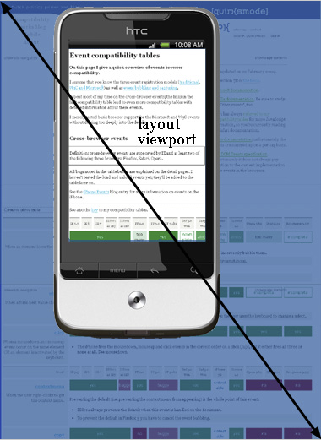
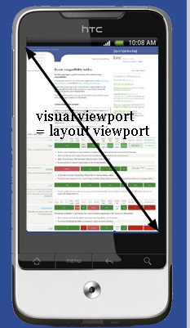

Slide 10
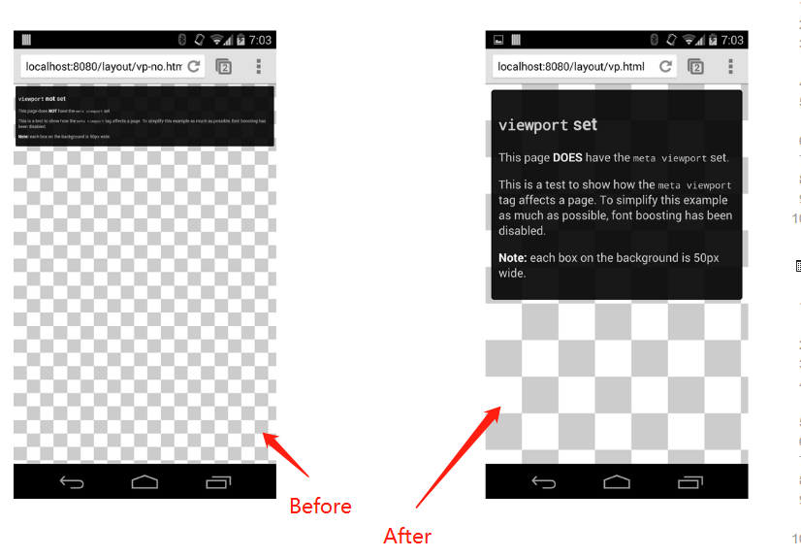

Slide 11
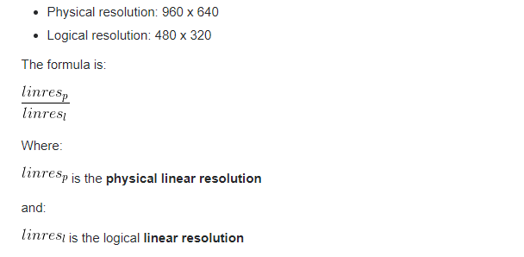
Dpr
Device pixel ratio
The device pixel ratio is the ratio between physical pixels and logical pixels. For instance, the iPhone 4 and iPhone 4S report a device pixel ratio of 2, because the physical linear resolution is double the logical linear resolution. Use window.devicePixelRatio to get the dpr

Slide 12
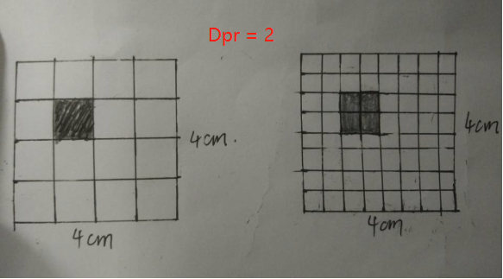
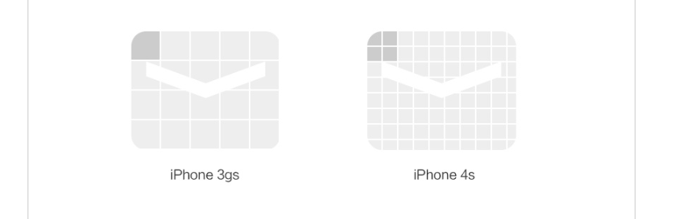

Slide 13
Rem
CSS3 introduces a few new units, including the rem unit, which stands for "root em“, this almost always means the font size of the <html> element
See here

Slide 14
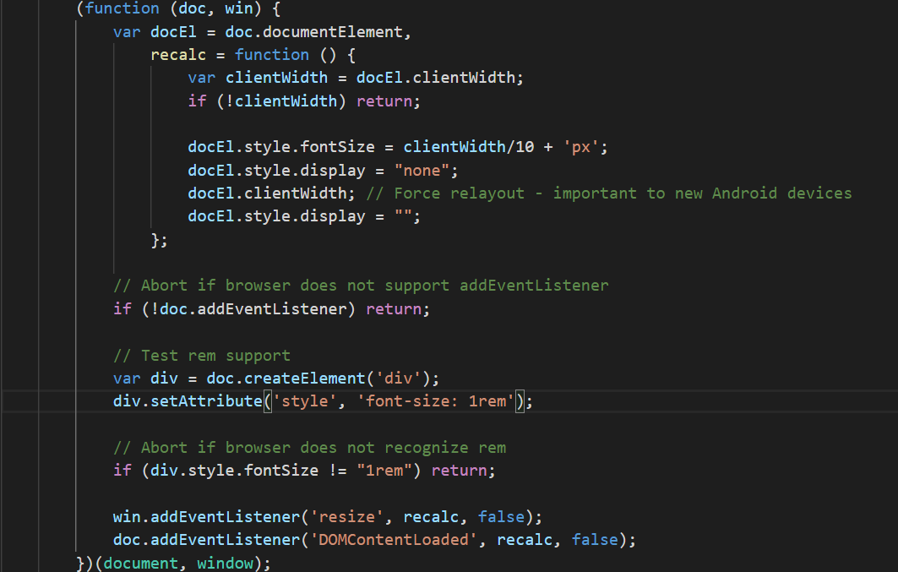

Slide 15
References
1. https://www.w3schools.com/cssref/css3_pr_mediaquery.asp
2. https://developer.mozilla.org/en-US/docs/Web/CSS/Media_Queries/Using_media_queries
3. https://snook.ca/archives/html_and_css/font-size-with-rem
4. https://en.wikipedia.org/wiki/Viewport
5. https://stackoverflow.com/questions/2939693/what-is-viewport-in-html
6. https://stackoverflow.com/questions/8785643/what-exactly-is-device-pixel-ratio
7. https://css-tricks.com/theres-more-to-the-css-rem-unit-than-font-sizing/
8. https://quirksmode.org/mobile/viewports.html

